Slide 1

Sharing data between child and parent directives and components

Slide 2

Slide Title
Sending data to a child component
Sending data to a parent component
Sharing data to any components

Slide 3
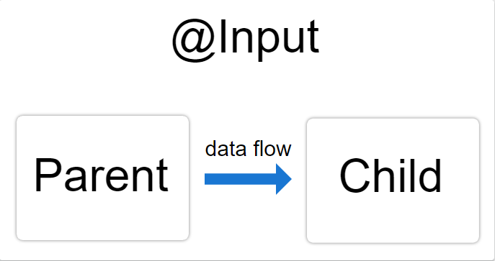
1. Sending data to a child component
@Input : to share a variable or value from a parent component with a child component inside

Slide 4
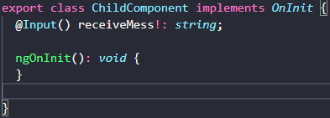

How to use @Input()
Configuring the child component

Slide 5

How to use @Input()
Configuring the parent component

Slide 6
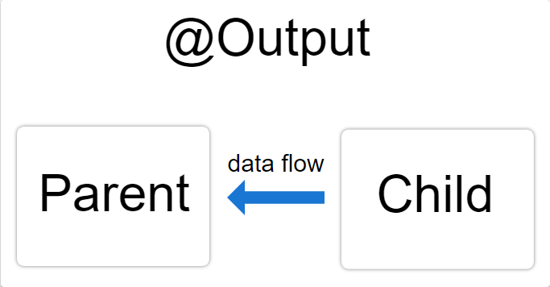
2. Sending data to a parent component
@Output: allows data to flow from the child to the parent

Slide 7
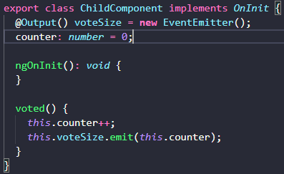
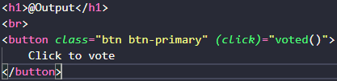
How to use @Output()
Configuring the child component
Configuring the child's template

Slide 8
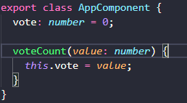

How to use @Output()
Configuring the parent component
Configuring the parent’s template

Slide 9
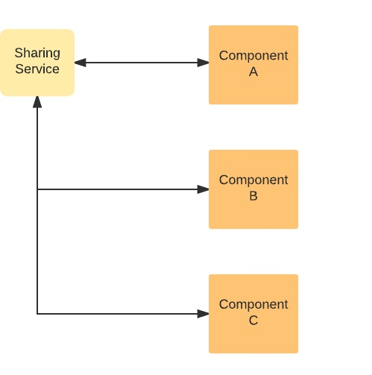
3. Sharing data to any components
Data service BehaviorSubject

Slide 10
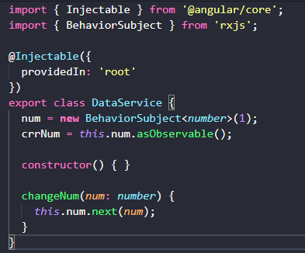
How to use sharing service
Generate Service class

Slide 11
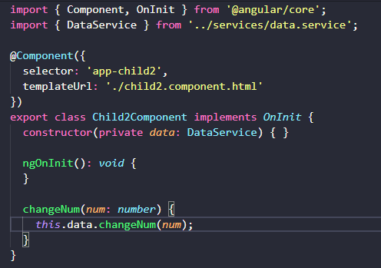
How to use sharing service
Call the changeNum() function in 1 component to push data

Slide 12
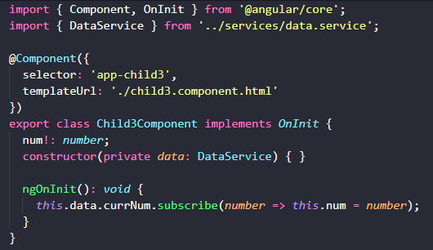

How to use sharing service
Subscribe into currNum to get data

